Slide 1
Kubernetes as a Jukebox
Modern Infrastructure as Code with
crossplane
Notes:
Introduction Storyline:
New Project / Greenfield
Move to the cloud from on-premises. No IaC at all.
Evaluate Technologies
Crossplane and Pulumi Contenders
During evaluation found spotify provider and decided to test it out for myself
Before we beginn: who has used: terraform, pulumi, cdk8s, crossplane

Slide 2


Your Navigator
Felix Hochleitner
Lead Cloud Engineer
Focus Areas
Cloud Architecture
Platform Engineering
Kubernetes
Developer Experience

Slide 3

Timeline
INTRODUCTION
Past
Dark Age
Present
Cloud revolution
Future
Plattform Engineering
Demo Time

Slide 4
01
Past
Present
Future

Slide 5

Learning to walk
Past
Manual configuration
Automation & scripting
Standardization
Notes:
In the beginning was clickops
Manual server configruations. Databses etc.
Dedicated Admins for everything and everything was a beloved pet.
Error prone. Not scalable. Most of the time not repeatable
Standardization:
Configuration management tools:
Ansible
Chef
Puppet

Slide 6
01
The cloud revolution
with great flexibility comes great complexity

Slide 7
02
Past
Present
Future

Slide 8

Gaining momentum
Present
More possibilities, greater flexibility
Rise in complexity
Advanced Infrastructure as Code needs

Slide 9

Infrastructure as Code with Terraform
Present
At its core a state machine for managing infrastructure lifecycle
The good
The bad
Providers for everything
Declarative language
Modularity & reusability
State management
Maturity
Community adoption
State management
Push-based / one-shot action
Limited control structures
Potential for drift
Complexity in large projects
Notes:
The Good
* Providers for everything
* Declarative language
* Modularity & reusability
* State management
* Maturity
Community adoption
The bad
* State management
* push-based / one-shot action
* Limited control structures
* Potential for drift
* Dependency management
* Complexity in large projects

Slide 10
02
Meanwhile…
Kubernetes, GitOps & what we can learn
from software engineering
Notes:
Kubernetes as defacto standard for application deployment (and more)
Continuous reconciliation
Desired state definition
Self-healing
GitOps:
Git as single source of truth
Audit trail on application deployment changes
Merge-/Pull-Request reviews for changes.
Automatic rollbacks and git reverts
Continuous reconciliation of desired state

Slide 11
03
Past
Present
Future

Slide 12



Crossplane
Future
A cloud-native framework for building control planes
Cloud native control plane for provisioning, managing resources
Extending Kubernetes API
Continuous reconciliation
Composable infrastructure using higher-level abstractions
ETCD for state management
“GitOps friendly”
Notes:
Kubernetes as unified control plane for management applications and infrastructure
Can leverage Kubernetes RBAC as well as admissions controllers for policy enforcement

Slide 13
Crossplane Core Concepts
Future
APPLICATION
Claims Composite Resource
Providers
Managed Resources
Composite Resource Definitions (XRD)
Compositions
Claims
CLAIM
App team concern
Platform team concern
COMPOSITE RESOURCE
DEFINITION
COMPOSITE
RESOURCE
COMPOSITION
Defines Composite
Resources and Claim
Composes Managed
Resources
Configures Composite
Resources
MANAGED
RESOURCE
Notes:
Providers: define interface to cloud providers or other APIS
Managed Resources: some resource that is managed by crossplane
Composite Resource Definitions:
Define interface/high-level abstractions to be consumed
OpenAPI V3 Spec.
Gets converted to Kubernetes Custom Resource Definition
Compositions:
Implementation of the XRD Interface
Contain multiple managed resources. Providers and are configurable
One XRD can be implemented by multiple compositions. Think Database XRD for Azure, GCP, AWS
Claims:
An instantiation of a XRD. Declared Composition to be used and creates ressources
Additional Benefits:
Configurations for Dependency Management
Composite functions. Extensibility

Slide 14
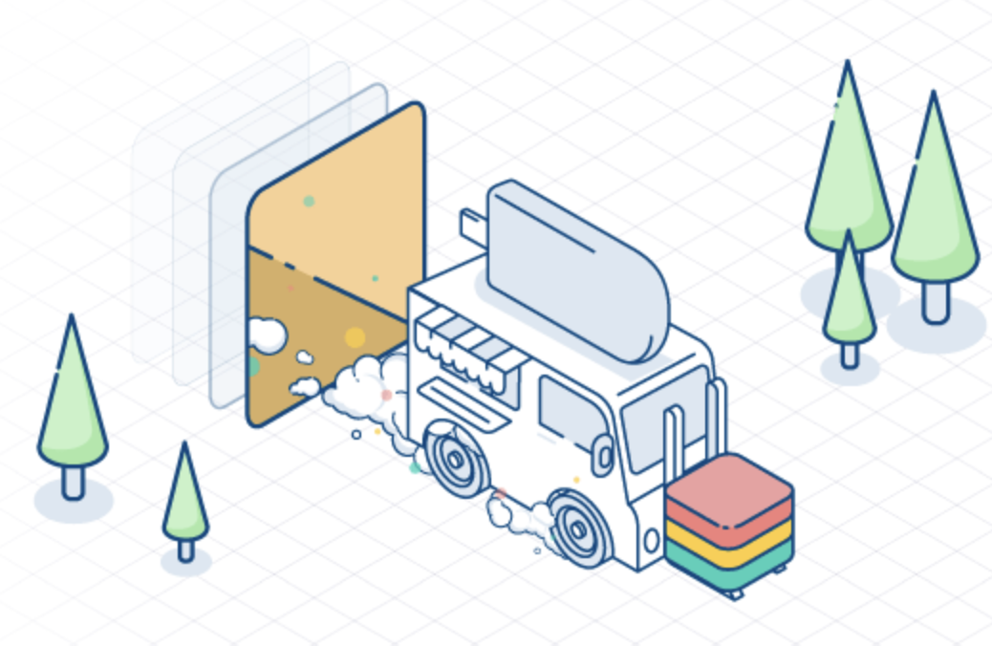
Well, that’s nice
Future
OCI compliable packaging
Dependency management
Extensibility (composite functions)
Connection secrets
Secret Manager integration
Marketplace
Helpful and active community

Slide 15
04
Demo Time

Slide 16
Not one. Not two. But four demos
Demo
The basics
Configurations
Composition
Literal COmposition
Installing a Provider
Creating S3 Bucket
Installing a Configuration
Dependency Management in Action
Understand how complexity can be abstracted
Integration with ArgoCD
Create an EKS Cluster
Kubernetes as a Jukebox
Creating a Spotify Playlist

Slide 17


Felix Hochleitner felix.hochleitner@squer.io proseccoboy@squer.io
Lead Cloud Engineer

